Slide 1

Canadian Hate Crime
Final Development Presentation Report
Submitted by : Group 12
Aravind Pradeep Kunnel
Omar Mukhtar
Namood-E-Sehar
Annee Mahida

Slide 2







Table of Content
Project Summary
Team Members
Timeline
Analysis & Visualization
Communication
Project Cost
Conclusion

Slide 3
Canadian Hate Crime Analysis: Summary
This project aims to look closely and examine the recent trends and patterns in hate crimes across Canada. By analyzing various data formats, this report unfolds and identifies the primary targets of these crimes, understanding the increase in incidents based on religion, race, ethnicity, and sexual orientation. Through this exploration, we seek to provide stakeholders with a clear, factual basis to develop informed strategies and policies. This analysis is crucial in facilitating a deeper understanding of the hate crime landscape in Canada and to empower stakeholders with actionable insights, enabling proactive interventions, policy recommendations, and community-driven initiatives.

Slide 4





Aravind Pradeep Kunnel
Omar Mukhtar
Namood-E-Sehar
Annee Mahida
Project Manager
Developer
Data Analyst
Business Analyst

Slide 5
Project TimeLine
Requirement Phase
Charter and Proposal
Retrieving Data
Development Phase
Data Cleaning & Analysis
Design Phase
Report Drafting
Visualization
Testing & Release
Final Presentation
Interpretation of results
Review &
Revision
Monitoring &
Evaluation
Final Report
Presentation

Slide 6

Requirement Phase

Slide 7
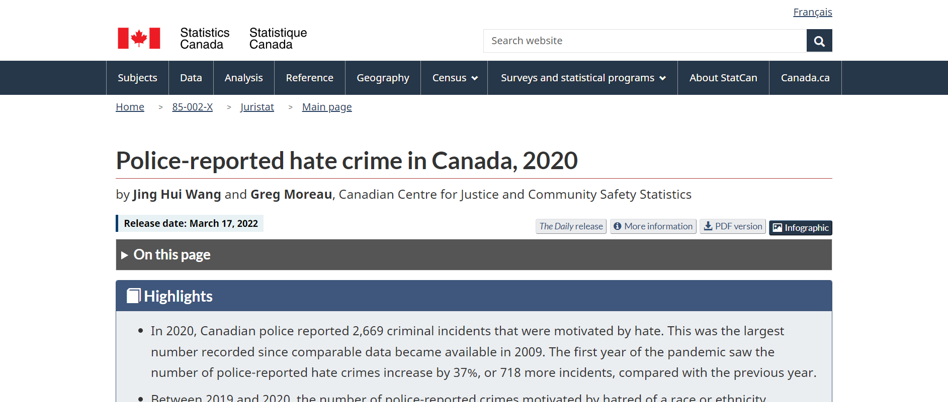
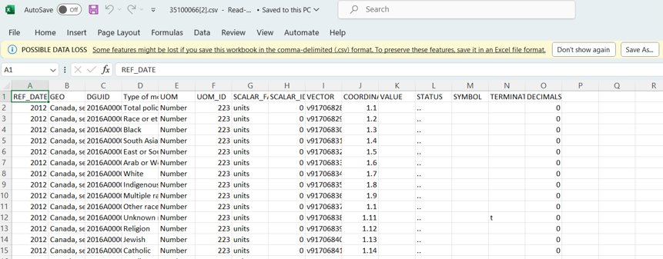
Requirement Phase
The Requirement Phase is a critical initial stage where the project team defines and documents specific project requirements.
This phase is not just about identifying stakeholders and understanding their expectations, but also involves the crucial tasks of gathering and cleaning data.
Briefly, Effective data collection is integral to forming a comprehensive requirements document, which stands as the project's guiding roadmap.

Slide 8
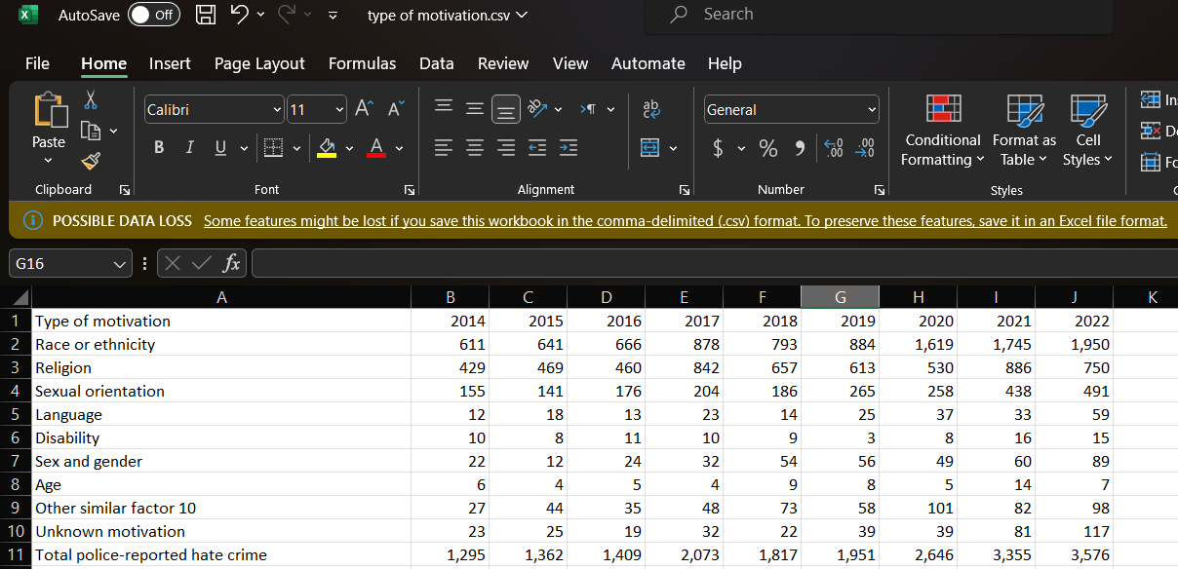
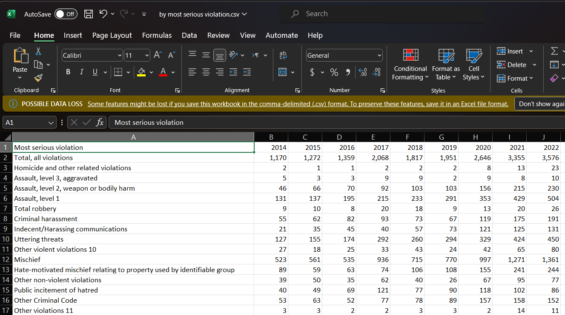
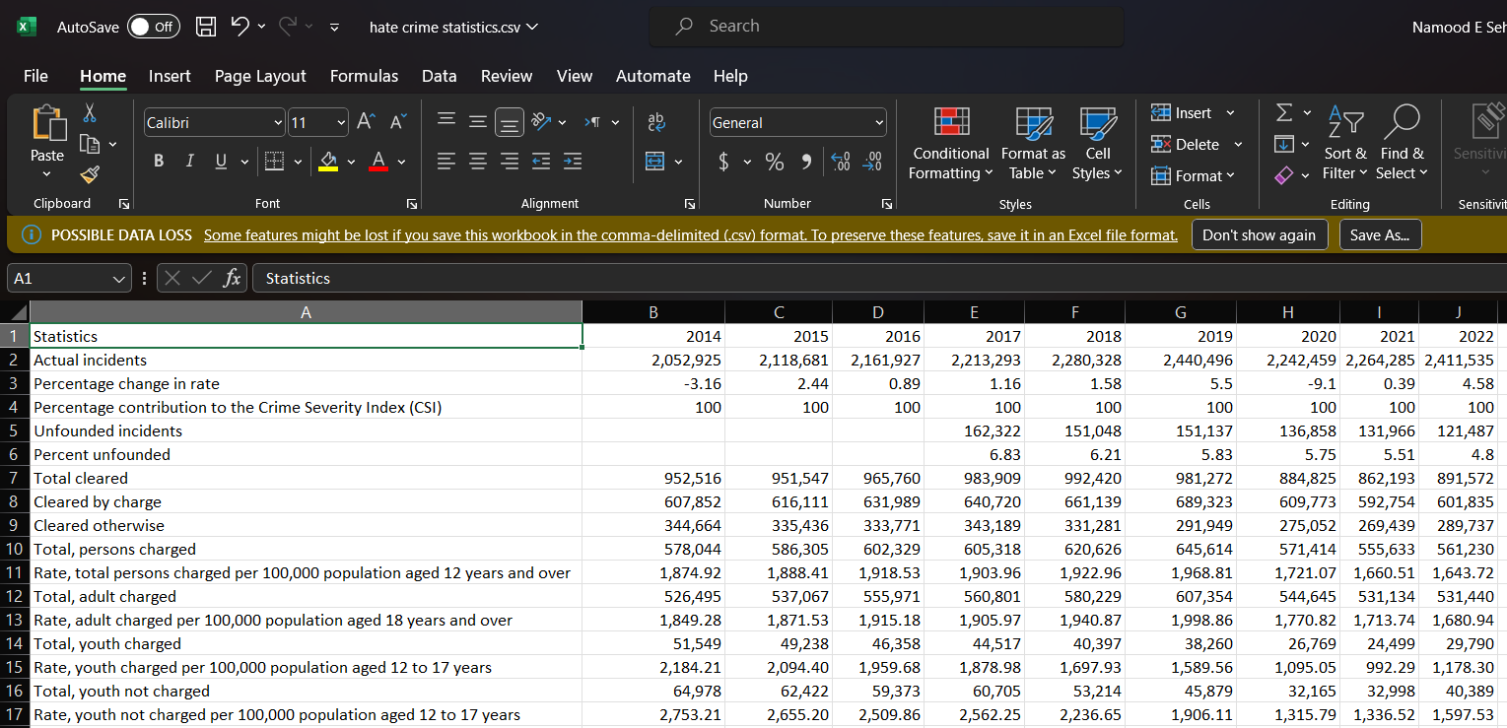
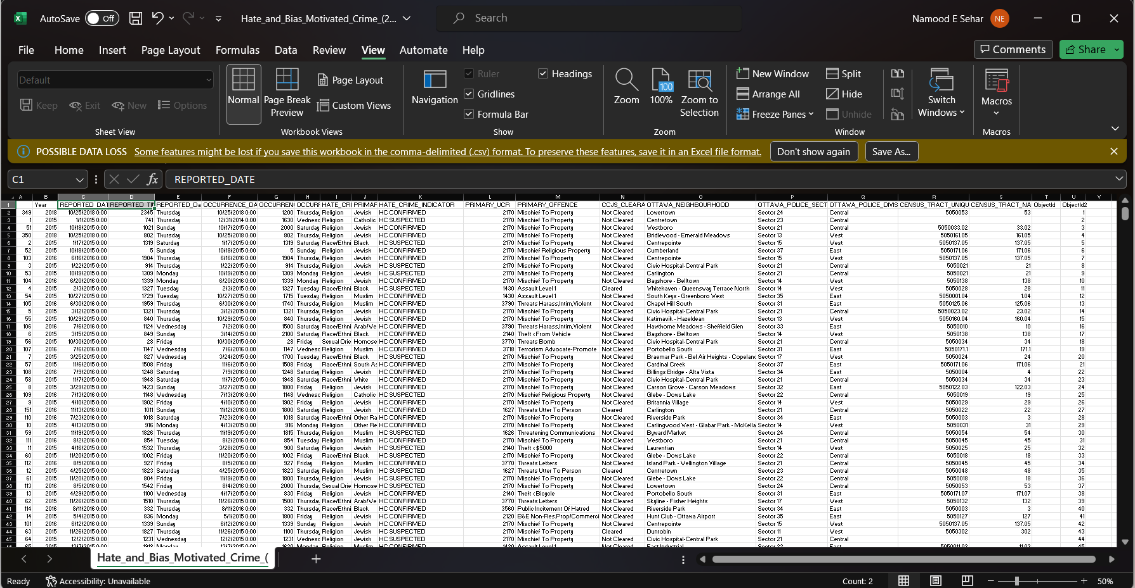
Snapshots of Datasets Collected For Analysis
Police Reported Hate Crimes By Type of Motivation
Police Reported Hate By Most Serious Violation
Police Reported Hate Crimes Statistics
Hate and Bias Motivated Crimes Ottawa
https://georgiancollege.maps.arcgis.com/home/item.html?id=a8b6defa93cc43cea925876ba8ea7cda#data
: Police-reported hate crime, by type of motivation, Canada (selected police services) (statcan.gc.ca)
Police-reported hate crime, by most serious violation, Canada (selected police services) (statcan.gc.ca)
https://www150.statcan.gc.ca/t1/tbl1/en/tv.action?pid=3510017701

Slide 9

Design Phase

Slide 10
Design Phase Task
Cleaning Raw Data
Exploratory Data Analysis
Graphs & Visualization
Cleaning raw data is an essential task This process involves a series of steps to ensure data quality, such as handling missing values, removing duplicates, filtering irrelevant information, and standardizing data formats. We use Python language to clean and finalize the datasets in Jupyter Notebook.
After careful cleaning and analysis, Exploratory Data Analysis was being initiated in Python. Libraries such as Pandas for data manipulation, Matplotlib, and Seaborn for visualization, and SciPy and StatsModels for statistical analysis were used for conducting EDA.
Graphs and visualization in data analysis play a pivotal role in communicating insights and findings derived from data. Visual representations such as charts, graphs, and plots helped to uncover insights, facilitate understanding, and communicate results in a compelling and accessible manner

Slide 11
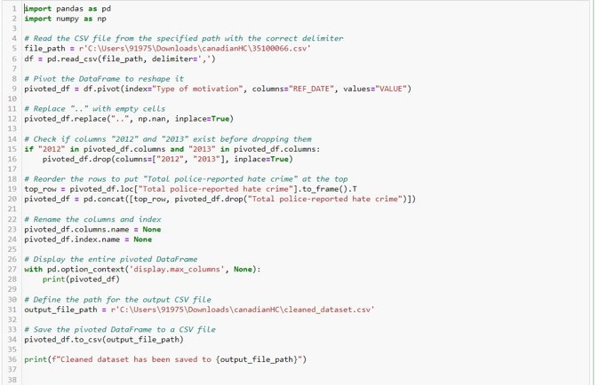
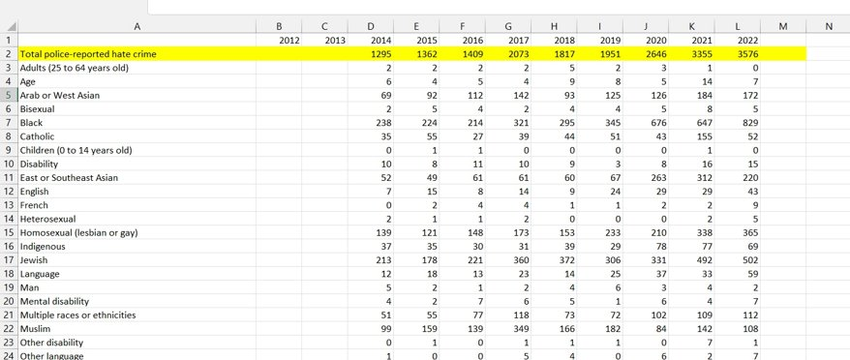
Cleaning Raw Data
Python Code
Row Data
Raw Data
Cleaned Data

Slide 12
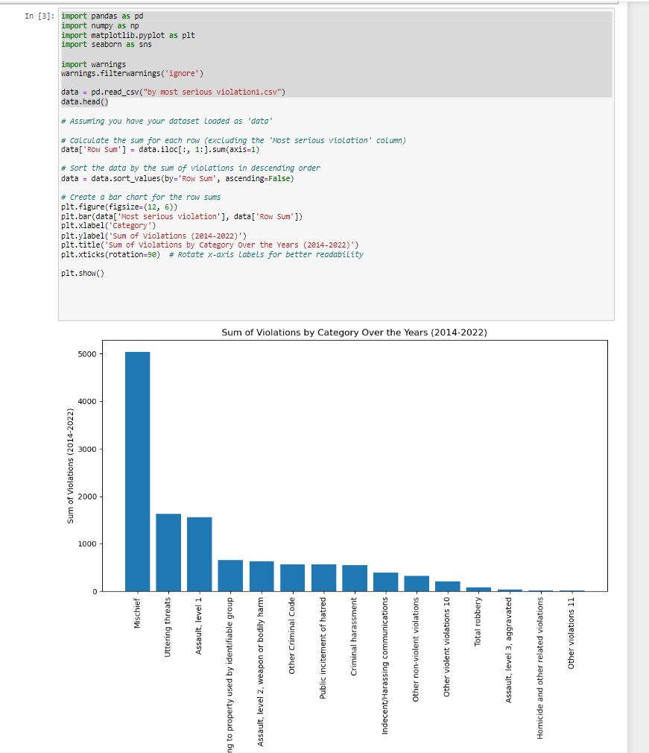
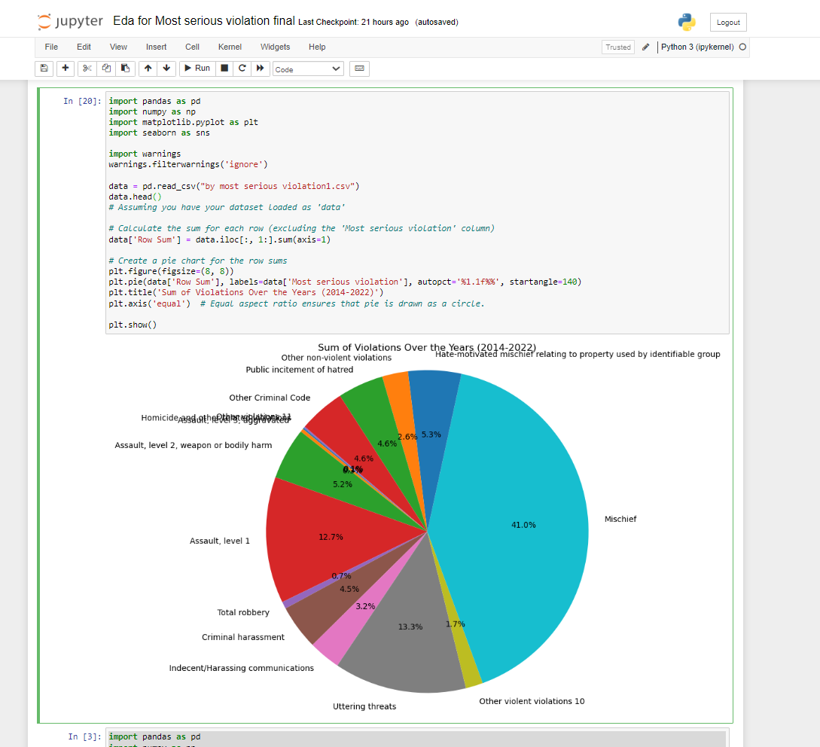
Exploratory Data Analysis

Slide 13
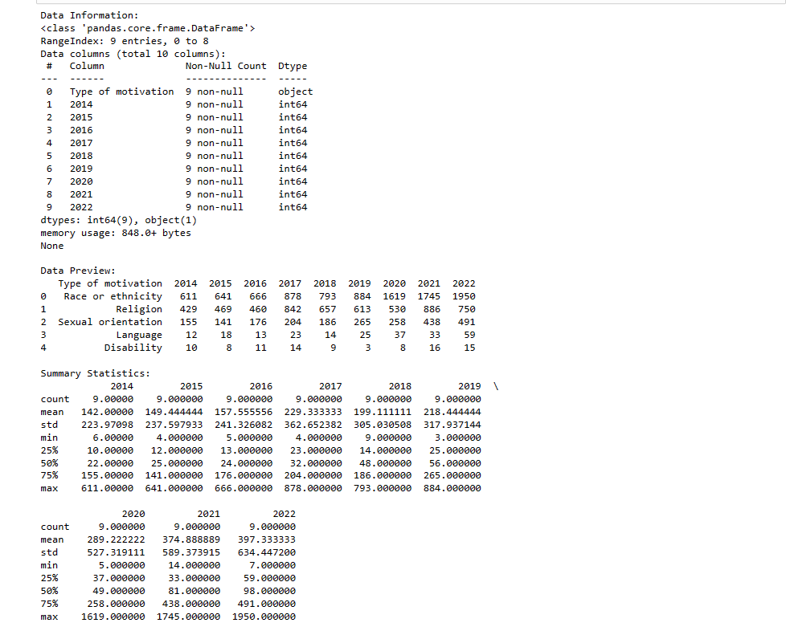
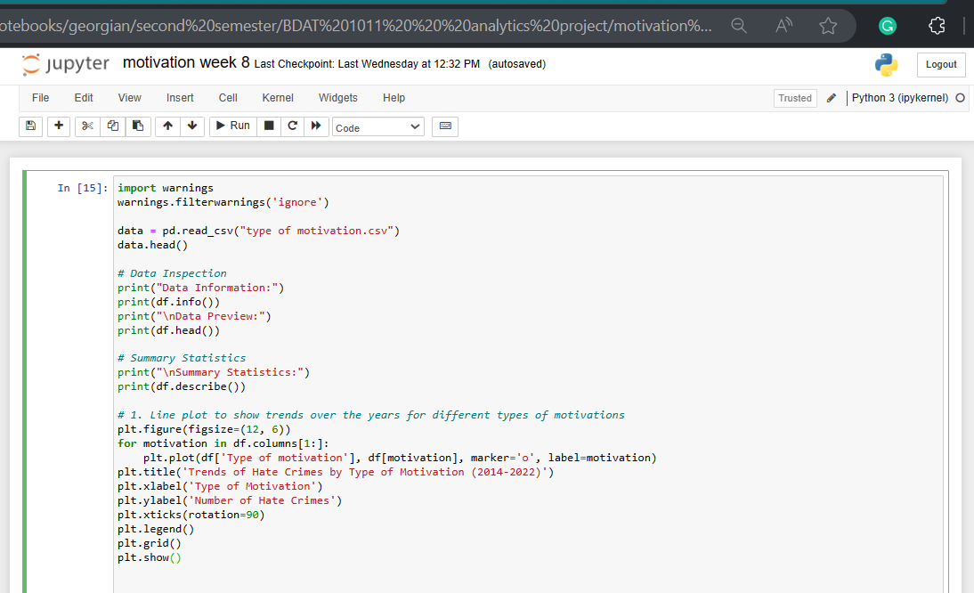
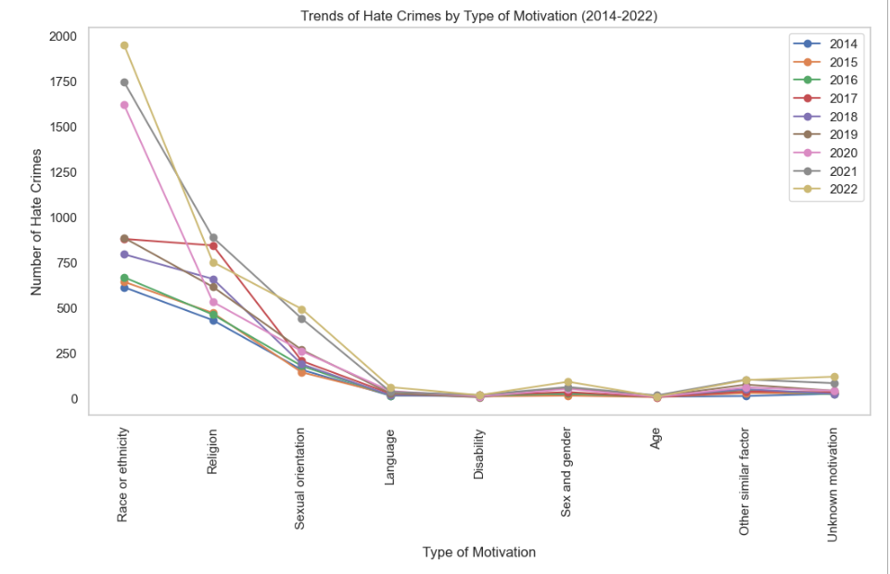
Graphs & Visualization

Slide 14
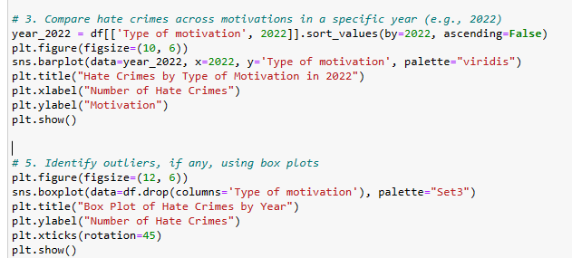
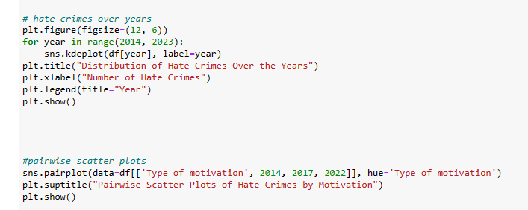
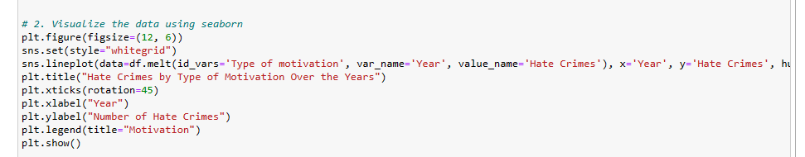
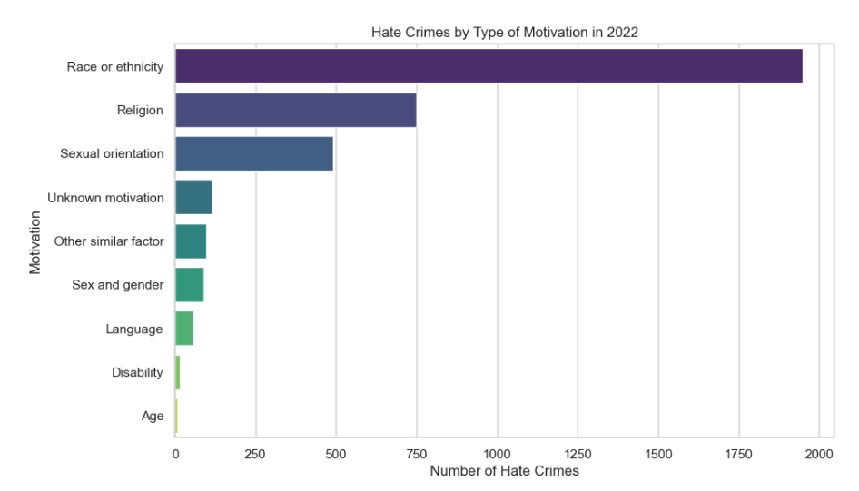
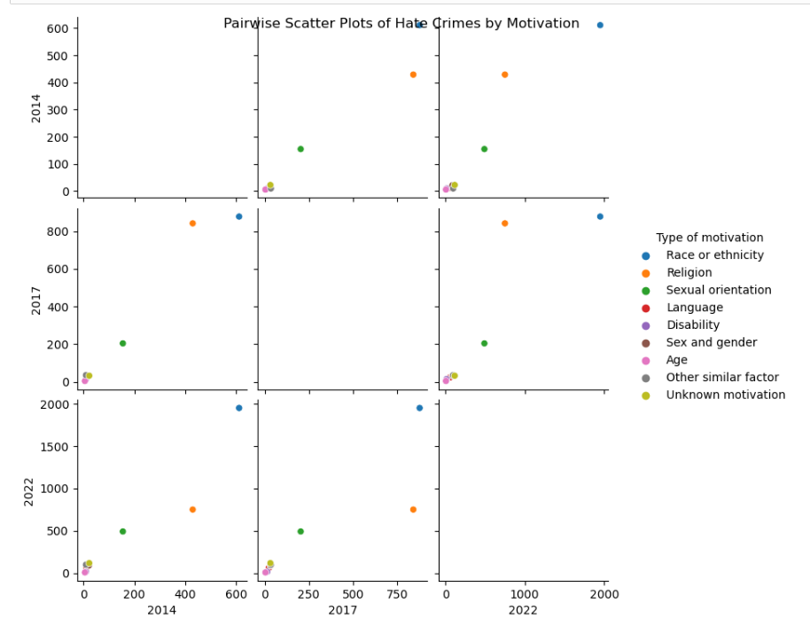
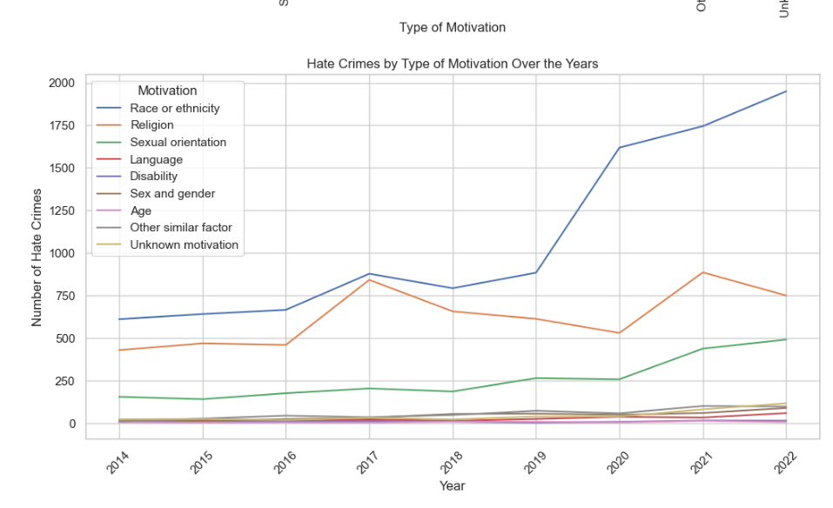
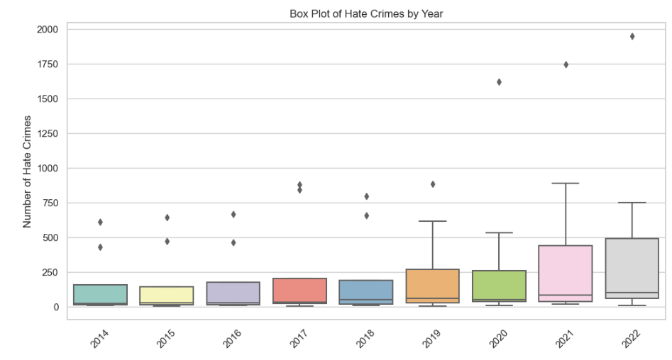
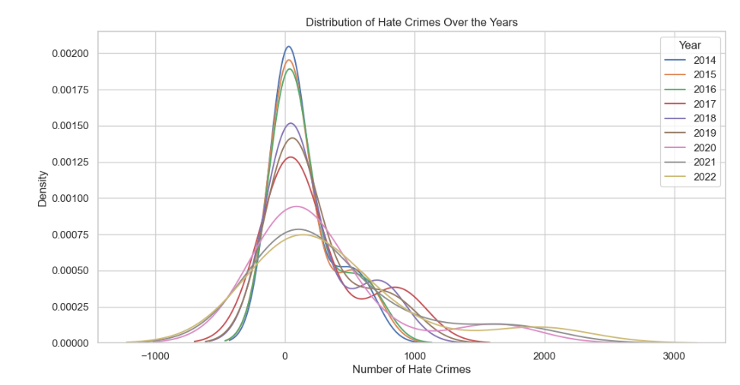
Graphs & Visualization

Slide 15

Development Phase

Slide 16
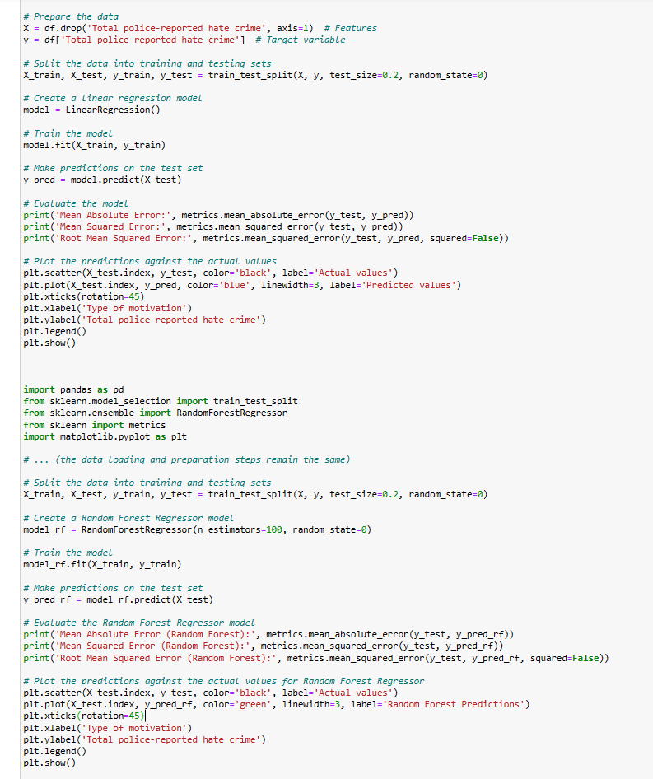
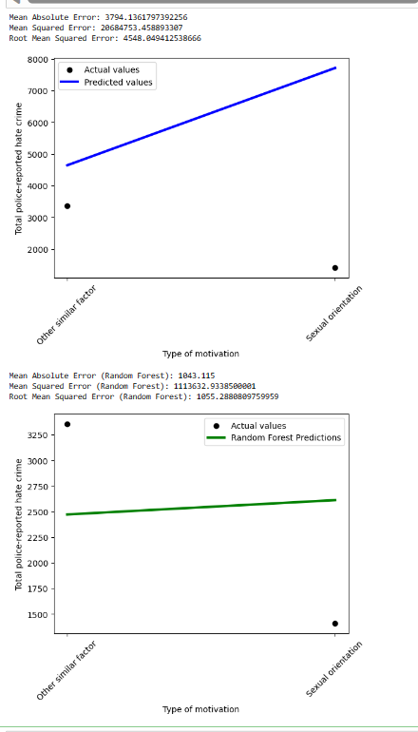
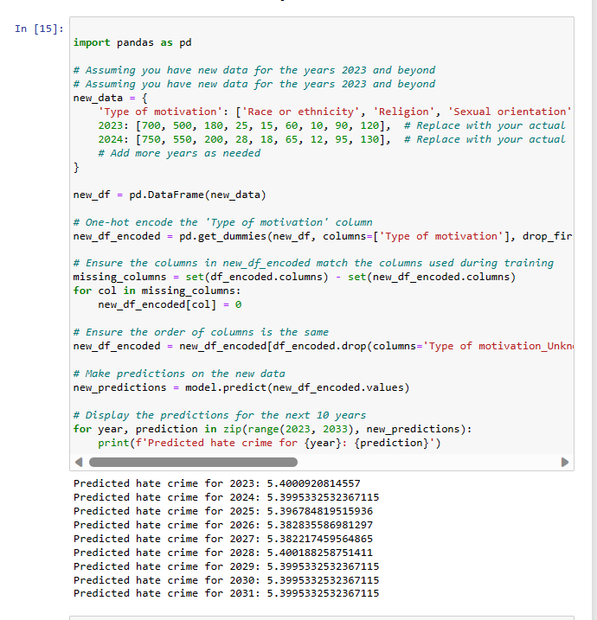
Predictive Analysis Development
This is a central aspect of the project, where the team focused on creating predictive models to analyze and forecast hate crime trends.
Utilizing Python for data processing and analysis, the team applies various machine-learning techniques to predict future occurrences of hate crimes in Canada.

Slide 17

StoryMaps
Surveying Hate Crimes Ottawa (arcgis.com)

Slide 18
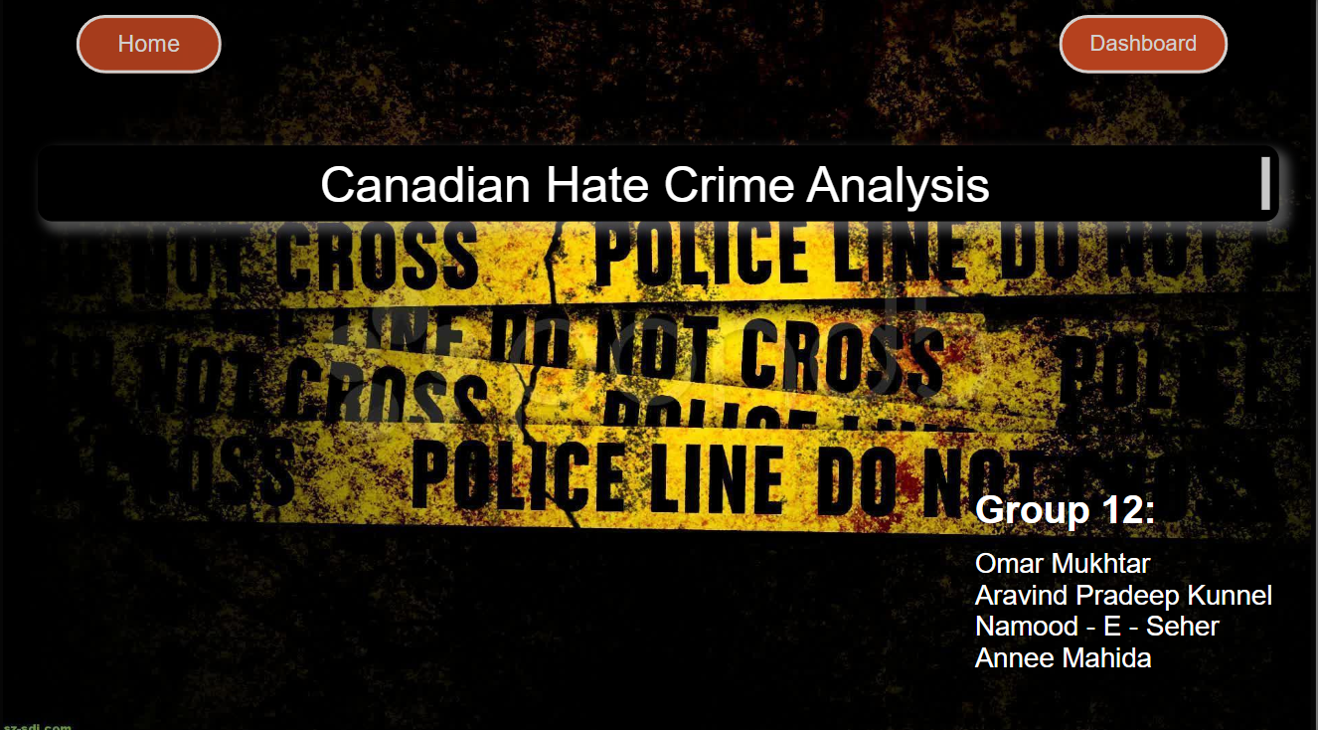
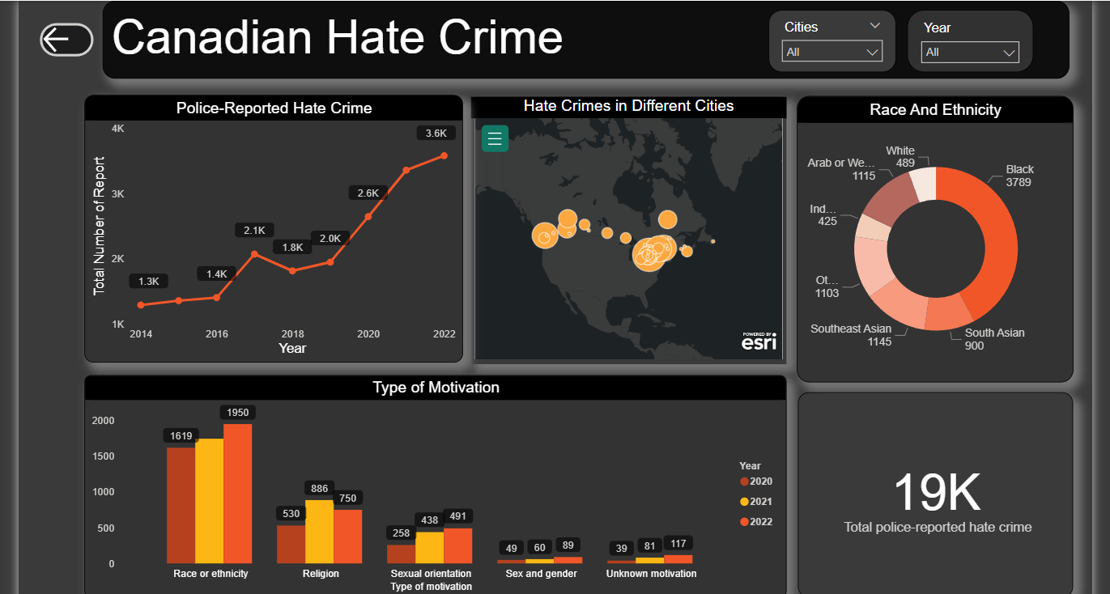
Final Dashboard

Slide 19

Communication

Slide 20
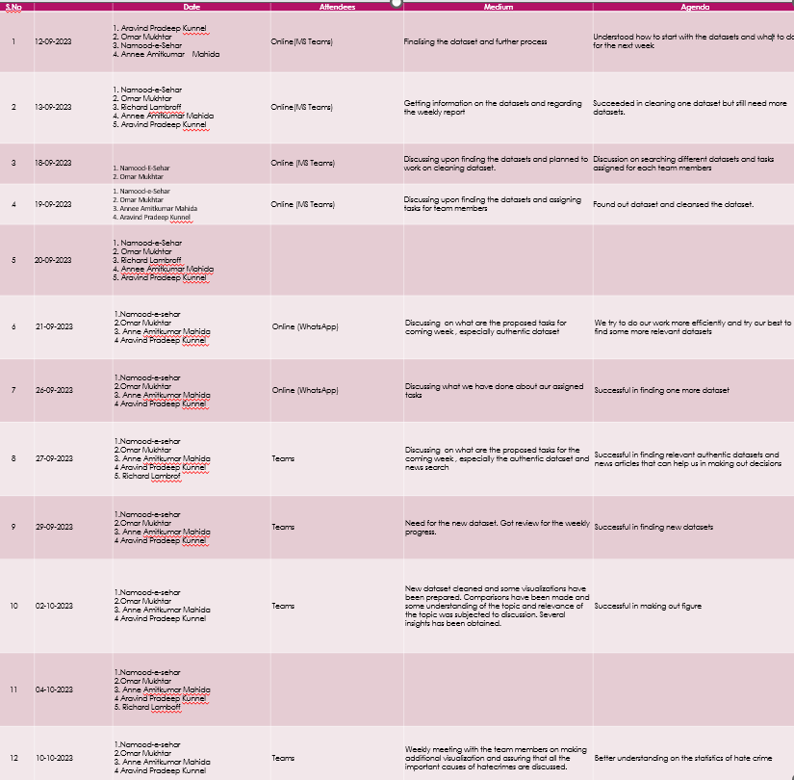
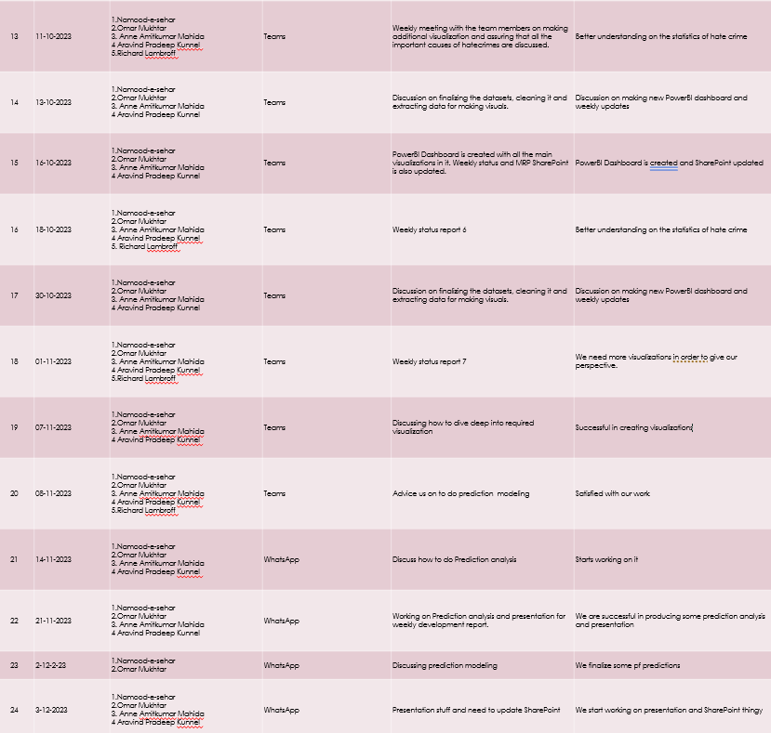

Slide 21
Project Cost

Slide 22
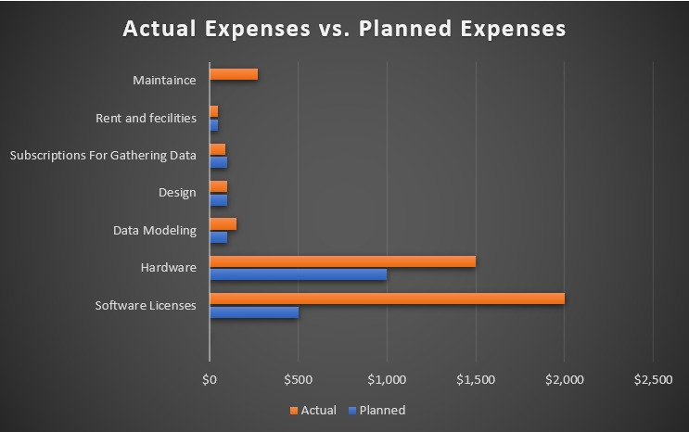
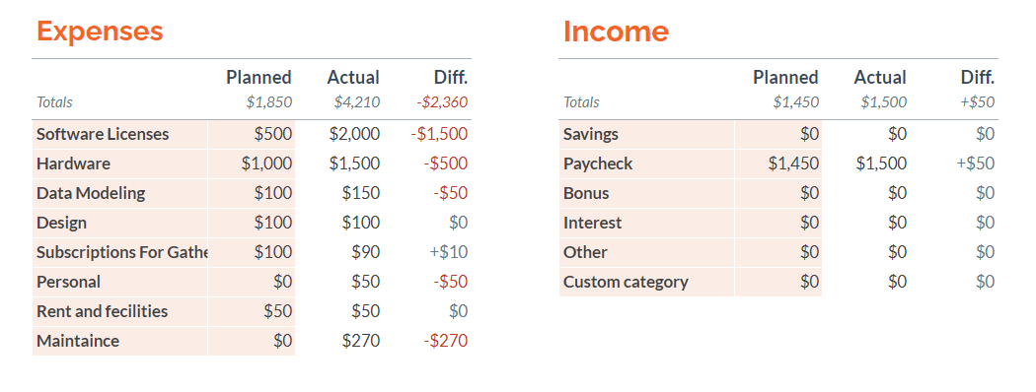
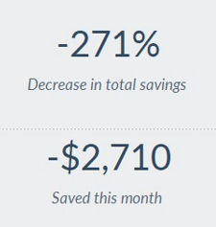
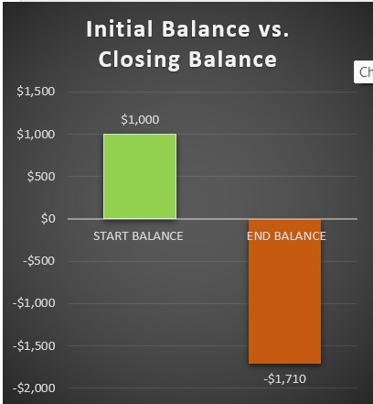
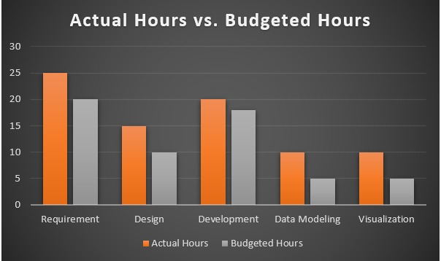
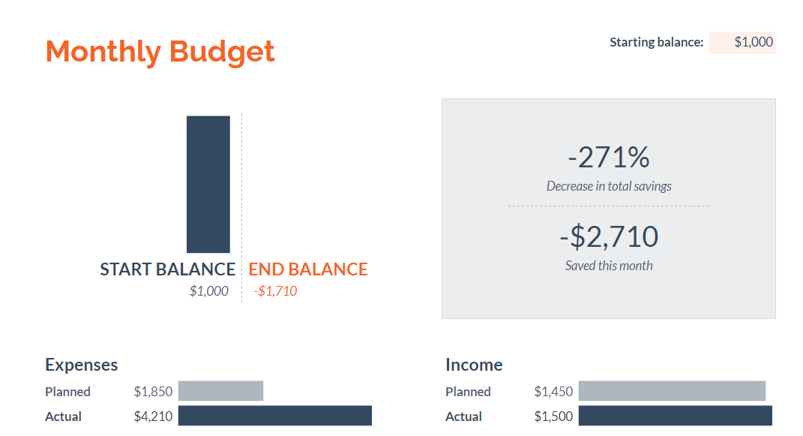
Project cost Visuals

Slide 23
Conclusion
The Hate Crime Analysis Project provided critical insights into the nature and prevalence of hate crimes in Canada. The analysis conducted through the project's dashboard and visualizations from python has revealed a concerning trend indicating a higher percentage of hate crimes being associated with race or ethnicity. This revelation serves as a stark reminder of the persistent societal challenges regarding racial and ethnic biases, reflecting a distressing reality within Canada's social fabric. The dashboard insights underscore the disproportionate impact of hate crimes targeting individuals or communities based on their race or ethnicity. The higher prevalence of such incidents signals deep-rooted prejudices and discriminatory attitudes prevalent in society. These insights shed light on the vulnerabilities faced by specific racial or ethnic groups, emphasizing the urgent need for interventions to address these disparities and promote inclusivity.
Ultimately, these insights underscore the gravity of the situation and emphasize the urgency to implement evidence-based strategies, fostering a society where racial and ethnic diversity is respected, celebrated, and protected against the scourge of hate crimes. The project's outcomes and evidence-based recommendations will be instrumental in informing policy decisions and interventions to mitigate hate crimes effectively.

Slide 24
Additional Research
https://www150.statcan.gc.ca/t1/tbl1/en/tv.action?pid=3510019101&cubeTimeFrame.startYear=2014&cubeTimeFrame.endYear=2022&referencePeriods=20140101%2C20220101
https://www.ctvnews.ca/canada/police-reported-hate-crimes-rise-again-as-pandemic-worsens-discrimination-statcan-1.6325705
https://www.cbc.ca/news/canada/nova-scotia/police-dispute-shooting-victim-s-hate-crime-claim-1.1025752
https://www.cbc.ca/news/canada/hate-crime-reports-jump-by-42-in-canada-1.1051249

Slide 25


